Slide 1
Exploring MSK Patient Pathways Facilitators and Barriers. And The Way Forward Rosie Smithson and Bruno Barbosa - Healthier Futures Academy Carolyn Casey - Consultant Physiotherapist July 2023

Slide 2
What is the starting point?
Hip Problem Definition:
Started with Quantitative data = patients from more deprived backgrounds are less likely to have Hip replacements
Analysis also indicates a trend towards most affluent having more Outpatients Appointments
Strongest Hip Replacement trends were in Sandwell and Walsall
We were asked to shed light on factors influencing this trend through understanding patients’ experiences
Refine Problem Definition:
Deep dive into Strategy Unit report
Existing research and policy/practice guidance
Develop understanding of the pathway
Explore Hip Consultants hypothesis
Attempted further quantitative analysis
Create a Focus:
On the whole pathway, experience of each ‘stage’, facilitators and inhibitors, understand the individual’s world
Flexible method to explore a range of pathways
Focus on surgery decisions where patients reach this stage
Notes:
Deep dive into Strategy Unit report
Attempted further quantitative analysis – into ethnicity, co-morbidities
Patients reaching different stages – understand their demographics – e.g. referrals, SC appointments, injections, offered surgery, decided to have/not have, delisted….
All Places in the Black Country demonstrated a common trend, with the least deprived patients receiving higher levels of THR. In Sandwell and West Birmingham (SWB) and in Walsall, this trend was statistically significant.
In Wolverhampton, SWB, and Walsall the analysis also found the least deprived patients received more outpatient referrals for OA Hip than the most deprived, and this was statistically significant in Wolverhampton.
The SU analysis was based on pre-covid data, hence was not influenced by issues caused by the pandemic.
In Dudley however, the most deprived patients are more likely to gain an outpatient referral, but this is not a significant trend.
We could not recruit via NHS
Could not just look at cases where surgery is and is not offered, and whether patient decided to have/ended up having
Also needed to see what happened earlier in pathway – leading up to referrals

Slide 3
Project Design
Initial Design:
10-12 Semi-structured interviews in Sandwell and Walsall with a mix of most and least deprived patients
Accessed through secondary and primary care patient lists
With patient and staff co-production workshops
Amended Design:
Accessed through voluntary and community organisations
No access to patient lists meant could not select list of patients appropriate for surgery, who did or did not have
Final Design:
Predominantly most deprived patients
Extended to Knee arthritis
Two focus groups with advanced physiotherapists
No plans for co-production workshops
Patient and Staff Experts:
Projects ideally involve a range of stakeholders to understand a range of patient pathway experiences and staff experiences of planning and delivering services
Recommendations are grounded in both sets of experiences
Clinical Leads
Patients
NHS Managers
Pain mgt staff
Clinic Nurses
Support VCOs
Consultants
Physio staff
Notes:
No plans for co-production workshops
Considerable staff resources already used on the project
Difficult to get the range of staff we would need there – to cover whole pathway
Complexity of getting patients together who have significant pain and mobility issues
Decided would re-visit idea of co-production workshops once done some dissemination and understood extent to which there is momentum, resources etc to act on the findings and proposals

Slide 4
Project Approvals
Ethics
Approached Trust Research and Development Teams – who approve research within secondary care
Walsall defined as formal research requiring Health Research Authority approval. We did not have resources for this and as a result could not recruit via secondary care NHS lists.
DPIA
For the whole project and transcription company (+ procurement).
CLG, CLN & Trusts
Approval and comments from Clinical Leadership Group and the MSK Clinical Learning Network.
Purpose, data collected, method, data storage & retention, consent, confidentiality,
Caldicott Guardian (full DPIA) as gathering sensitive data.
Consultation with Orthopaedic consultants and Place Transformation Leads.
DPIA

Slide 5
Patient Recruitment
Via VCS
Pre-Screening
Information sheet & consent form
Venue and Method
Patient Preference
Interviews Digitally Recorded
Transcribed
and
Coded
Thematic Analysis
Frame Overall Argument
Fieldwork to Dissemination
Report Writing
Information Sheet & consent form
Physio Staff Focus Groups
Disseminate Results

Slide 6
Information Sheet and Consent form: The Fundamentals
Who is conducting the project and why?
How information gathered will be used & intended outcomes
Eligibility for taking part
The ask: interview, duration, method, sensitive/personal info gathered, managing expectations
Gifts/recognition
Confidentiality and anonymity
Duty to report harm
Voluntary participation and details of withdraw
Collection, storage, sharing and deletion of data gathered
Written and audio records
Contact details
How to complain
Consent sheet: asking for explicit permission against key aspects
Traditionally signed paper copies, sometimes scanned signature; for this project verbal consent
Confirm received and understood at the start of the interview

Slide 7
Interview Schedule
Developed in collaboration with Clinical Lead Expert and Project team
Circulated to Orthopaedic Consultants
Essential interviewers know the schedule well, can move back and forth through the questions
Take account of numerous pathway variations:
Primary care
Patient initiated actions (or not)
Physio (or not)
Consultant (or not)
Pain injection (or not)
Offered surgery (or not)
Accepted surgery (or not)
Waiting list
Discharged to GP
Had surgery
Experimented with multiple structures and piloted
Introduction:
Revisit informed consent
Length interview
Stop, take breaks etc.
Audio recording, start recorder
Shopping voucher delivery
Opening question:
Can you tell me a little bit about when your hip arthritis developed and the impact it was having on your day-to-day life?
End housekeeping:
Thank you
Copy of report
Address for vouchers

Slide 8
Fragmented Pathway: Findings Framework
Organisational Factors
e.g., Processes, Policies
Practice, Culture
Service Design
Arthritis Pathway
Fragmented professions/services
Patients move between professionals/services
Patients need to co-ordinate and self-manage
Patients have variable awareness and understanding of pathway and their role
Smooth Journeys
Complex Journeys
Patient Factors
e.g., Health literacy
Communication skills
Resources
Values, Perceptions, Beliefs

Slide 9
Key Patient Reported Findings - PRINT
1. Appointment Booking & Communications | Phone and online booking issues Making secondary care appointments Waiting until conditions are advanced Missed hospital phone appointments
4. Referrals & experiences of secondary care | Long periods with no communications Waiting for referrals and appointments Cancellations and need to chase Not integrated Impact on mental health Lack of patient choice
2. Primary care appointments | Mixture of positive and negative experiences Some patients felt dismissed 10 min appointments Lack of continuity in professionals Need to push for referrals Often direct to imaging referrals
5. Orthopaedics’ surgery decision making | Decisions based on: condition severity, age – re: replacement longevity, and BMI Very limited weight loss support and info Declined patients felt left to live in pain No plan of when surgery may happen Mixture of excellent communication by consultants, through to poor understanding
3. Conservative management | Many had physio referrals, but sometimes late in the process. Only one FCP experience Limited No. physio sessions, not convinced of benefits, varied engagement, pain experienced Ineffective pain relief, not explored in Apts Limited understanding of conservative mgt; focus on secondary care referral and potential surgery Injection waiting times
6. Patients’ surgery decision making | Patients considered: Pain, previous surgery, financial position, future ability to work, recovery support, health risks, others surgery stories Negative previous surgery, unsuitable housing and other life/health stressors had greatest negative impact on decisions

Slide 10
Patient Reported Findings
Appointment Booking & Communications
‘You can't get through. The system cannot cope’ ‘Fill the form in online, I’m really slow at it, then it says, “Ring your GP for an appointment”’ ‘Now they send a letter, and you have to book. We aren't good with technologies, and getting through on the phone is hard’ ‘I hate being a nuisance, I’ll put up with things until they are really getting to me’ ‘Both legs are really swollen. The consultant cannot see that, face-to-face would be better’
2. Primary care appointments
‘My current doctor has listened; I wouldn't know what was wrong. He explains more than the hospital’ ‘One GP was excessively dismissive. “Well, what do you expect? We all get knee pains as we get older”. He focused on my weight, made a judgement, he did not listen’ ‘‘’That’s about 4 things you’ve asked. You’ve had your 10 minutes”. They couldn’t wait to get rid of me. I’m limping out, she didn’t ask about my hip’ ‘”I think I have something wrong with my leg. I want a scan”. They referred me, I didn't think they would, a lot of the time you can't get what you want’
3. Conservative management
‘It’s still painful when you are doing the exercises, but it’s helped’ ‘I try to do them, but I don't feel like they listen. It's the pain I’m in’ ‘They just put me on the list that's all but I haven't heard anything more’ ‘I just threw the exercises in the bin’ ‘”If you were taking your medications, you wouldn’t be in pain”. I felt angry because I’m taking all of them’ ‘I don't know if I’m meant to have aspirin and ibuprofen, and paracetamol, I'm having them anyway’ ‘I don’t want to suggest I know better. How can I say, “is it possible to have the injection in a hospital?”’

Slide 11
Patient Reported Findings
4. Referrals & experiences of secondary care
‘”We’ll call you in 3 months”. They never rung back. If we hadn't phoned, I don't think I'd have got this appointment’ ‘They cancel appointments 6 or 7 times. I got appointment letters, and the next day another saying it’s cancelled’ ‘You kind of go off the radar’ ‘The pushing, it’s draining, takes a lot of time and energy, chasing things up’ ‘I do not like Sandwell, I prefer city. I had things go wrong at there’ ‘They asked if I've got a preference, a local hospital? I said, “No, I'II travel, get me the one with the shortest list”.
5. Orthopaedics’ surgery decision making
‘”It’s worn out. When do you want to come in? It will seize if don’t have it”’ ‘Hip surgery, only lasts for so long? Ten years? He was leaving it until I'm older’ ‘What am I to do for 20 years? The pain is worse. No reviews, and you don't get any other information. Will it get to the stage I can’t walk?’ ‘“You’re obese, We have to take you off the list”. I was devastated’ ‘Really good. He had the x-ray and explained it well. He was very professional and helpful’ ‘They could explain things a lot better, what osteoarthritis is, the changes. Don't just say, “You've got hip arthritis”
6. Patients’ surgery decision making
‘I was worried about having the operation, because of things that could go wrong, but I needed it, I was in so much pain’ ‘I wanted to earn as much money as I could, for after the operation. I will need someone to look after my dog, and all the rest of it’ ‘My daughters are busy with their children. My Social Prescriber will probably keep an eye on me’ ‘Dead worried, I've been smoking for years. This was in my mind…[but] it didn’t occur to me to ask the consultant’

Slide 12
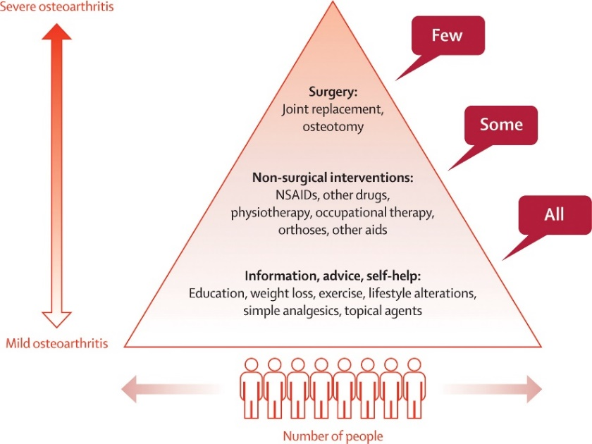
Treatment Triangle
Lohmander, L, S. and E, M. Roos. (2007). Clinical Update: Treating osteoarthritis. The Lancet. 370. (9605). pp. 2082-2084. https://doi.org/10.1016/S0140-6736(07)61879-0 (Accessed on 04/05/2023)

Slide 13
Our Patients
Wider significant health issues
Mild to very debilitating and painful Arthritis
Many lived alone
High deprivation
&
Limited resources
Difficulties functioning at home
Made self-management hard
Made overcoming barriers hard
Less able to utilise opportunities
Dependant on others
Social housing
Individual’s Lived Experience
Restricted activities outside the home
Low levels of employment
Values (e.g. burden, professionals know best)
Middle to older adulthood
50’s to 80’s
Varied Health Literacy and Confidence
Perceptions
Service Experiences
Notes:
Patient Profile Summary
Patient Place Locality:
4 patients from Sandwell
11 patients from Walsall
Gender:
4 male patients
11 female patients
Ethnicity:
2 Afro-Caribbean
1 Indian Hindu
1 British Pakistani
11 White British
Age:
5 patients = 50 – 59 yrs. old.
2 patients = 70 – 79 yrs. old.
5 patients = 60 – 69 yrs. old.
3 patients = 80 yrs. old. +
IMD Deciles:
1 is most deprived
12 patients = Decile 1 or 2 = 12
1 patient = Decile 4 = 1
2 patients = Decile 8 or 9 = 2
Type of Arthritis:
7 patients had Hip Arthritis
3 patients had Knee Arthritis
5 patients had both Hip & Knee Arthritis
Co-morbidities:
(Other than Hip and Knee Arthritis)
Number of additional Co-morbidities:
3 patients = no other co-morbidities
6 patients = 1 to 3 other co-morbidities
6 patients = 4 + other co-morbidities
Most common additional co-morbidities:
4 patients = Diabetes and high cholesterol/pressure
3 patients = High BMI
3 patients = Asthma
3 patients = Mental health
3 patients = Other arthritis and MSK problems

Slide 14
Improvement Options
1. FCP Assessment Appointments | Consistent use of FCP as first point of call for MSK patients. Promote expertise of role. Ensure accessing conservative mgt options and triage before Orthopaedics referrals
4. Personalised Support for MSK Mgt | Identify staff to deliver Personalised Support – e.g., FCPs, MSK trained Health Coaches, Tier 2 services. Shared Decision Making Surgery education and expectation mgt Support patients to access surgery where appropriate treatment Create share care plans Educate/Prepare for re: secondary care apts Help overcome pathway barriers Help mgt other interacting LTCs Support weight loss Strengthen physio referrals and education/ motivation re: importance Pain mgt coaching Signpost to other services Ensure meet cultural and language needs
2. Longer Primary Care Appointments | More time for patients and GP/primary care staff to understand MSK condition and interaction with other health issues. Raise awareness of conservative mgt
3. Regular MSK Reviews in Primary Care | Oversee long-term mgt: monitor progression, referrals, address drift, medication reviews…. Create OA register to identify patients – ideally in QOF incentivised

Slide 15
Improvement Options
5. Improve Communications and Explanations in Secondary Care | Use of visual aids in explanations, leaflets, writing notes, contact print outs, simple language … Staff to debrief patients as leave apt, check understanding and next steps Ensure access to physical and virtual apts, to assess condition progression
7. Review Surgery Measurement Outcomes | Review outcomes to reflect the complexity of working with more complex and vulnerable patients – need more resources Link surgery with these patients to ICB delivery of core20+5 agenda? Do tariffs adequately reflect the complexity of surgery with these patients?
6. Surgery Decision Making & Communication to Patients | Improve patient understanding and engagement in decisions; SDM Raise awareness of patient choice Review how BMI criteria applied and impact of harmonisation policy. Case by case approval BMI 40 + Review explanations of age/severity – when surgery may be appropriate Ensure future aspirations considered in decisions, not just current activities - How reduced pain and increase mobility may expand patient activities?
8. Review the Patient Initiated Follow-up Policy (PIFU) for MSK patients | Clearly set out how PIFU can be used by MSK patients to request follow-up Raise awareness and explain to patients Help avoid drift and having to start the referral process again

