Slide 1
Building Intuition:
Analytical Concepts for Leaders
Mohammed A Mohammed

Slide 2
Timings
1000 – start
1100-1115 AM Break
1245-1330 Lunch Break
1430-1445 PM Break
1530 - Close

Slide 3

The most precious gift you can give someone is the gift of your time and attention
Nicholas Gumbel

Slide 4
Socratic exercises
Fun
Fear-free
Engaging
Challenging
Review & Learning

Slide 5

Socratic exercises
Fun
Fear-free
Engaging
Challenging
Review & Learning

Slide 6
Why?

Slide 7
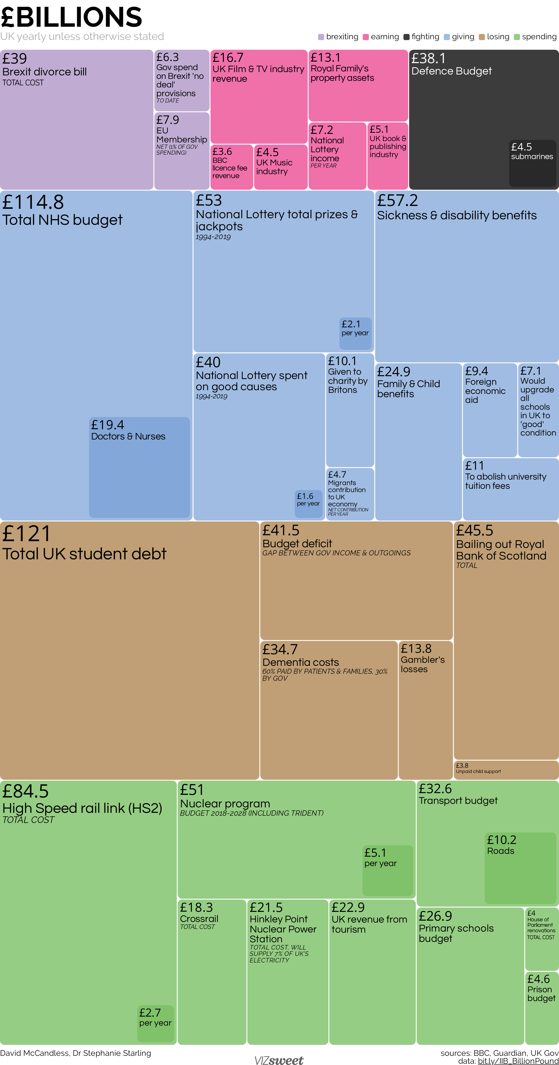
Nov 2019
https://www.informationisbeautiful.net/visualizations/the-billion-pound-o-gram/

Slide 8
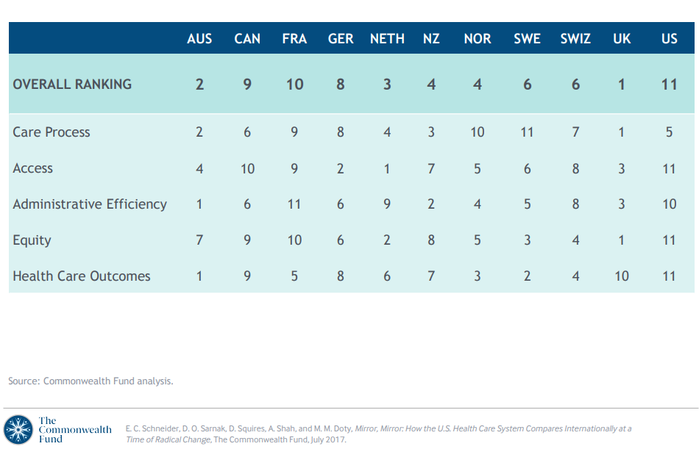
Notes:
https://www.commonwealthfund.org/sites/default/files/documents/___media_files_publications_fund_report_2017_jul_pdf_schneider_mirror_mirror_exhibits.pdf

Slide 9
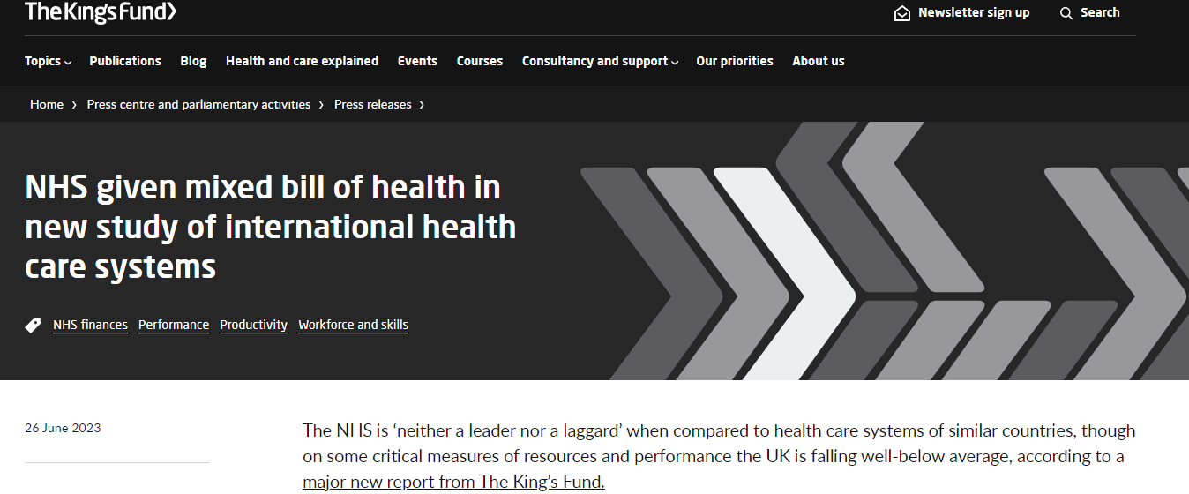
Notes:
https://www.kingsfund.org.uk/press/press-releases/nhs-mixed-bill-health-international-health-care-systems

Slide 10
“Statistical thinking will one day be as necessary for efficient citizenship as the ability to read and write.”
― H.G.Wells (misattributed 1903)
https://www.sciencedirect.com/science/article/pii/0315086079901010
Notes:
Statistical thinking will one day be as necessary for efficient citizenship as the ability to read and write! Quote from the presidential address in 1951 of mathematical statistician Samuel S. Wilks (1906 - 1964) to the American Statistical Association found in "JASA",Vol. 46, No. 253., pp. 1-18. Wilks was paraphrasing Herbert G. Wells (1866 - 1946) from his book "Mankind in the Making". The full H.G. Wells quote reads: "The great body of physical science, a great deal of the essential fact of financial science, and endless social and political problems are only accessible and only thinkable to those who have had a sound training in mathematical analysis, and the time may not be very remote when it will be understood that for complete initiation as an efficient citizen of one of the new great complex worldwide States that are now developing, it is as necessary to be able to compute, to think in averages and maxima and minima, as it is now to be able to read and write."

Slide 11
Sally Clark & Sudden Infant Death Syndrome (SIDS)
In 1996, her first son died apparently of SIDS (also known as "cot death") at a few weeks of age.
In 1998, her second son died similarly.
1999 she was convicted for their murder
Expert witness for the prosecution said the chance of the two deaths happening accidentally was 1 in 73 million.
  The expert used the following method to calculate the probability:
  The probability of SIDS in an affluent family where neither parent smokes and the mother is aged over 26 is approximately 1 in 8500.
  The probability of this happening to both of the children is therefore (1/8500)²=1 in 73 million (1/72,250,000)
There was virtually no other evidence
After 2 appeals, the conviction was quashed (2003).
2007 - she died at home from alcohol poisoning.
11
The prosecutors fallacy

Slide 12
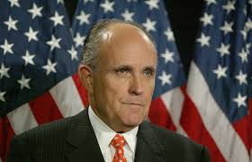


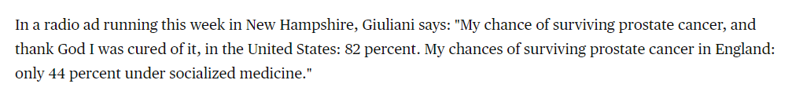
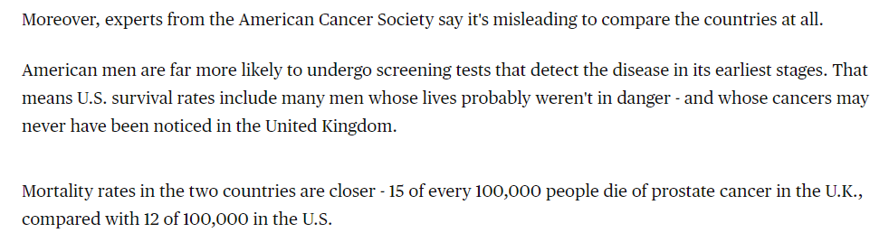
https://www.nbcnews.com/health/health-news/giuliani-defends-his-cancer-survival-comparison-flna1c9473681
Notes:
https://www.ncbi.nlm.nih.gov/pmc/articles/PMC1117639/ - Series of errors led to 300 unnecessary mastectomies
https://www.ncbi.nlm.nih.gov/pmc/articles/PMC1172083/ - German women to receive quality controlled breast screening

Slide 13
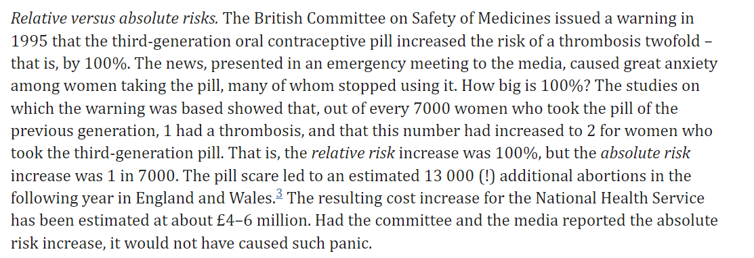
The 1995 Pill Scare
Gerd Gigerenzer 2009: Bull World Health Organ 2009;87:567 | doi:10.2471/BLT.09.069872
Notes:
https://www.ncbi.nlm.nih.gov/pmc/articles/PMC2733256/#:~:text=The%20British%20Committee%20on%20Safety,that%20is%2C%20by%20100%25.

Slide 14
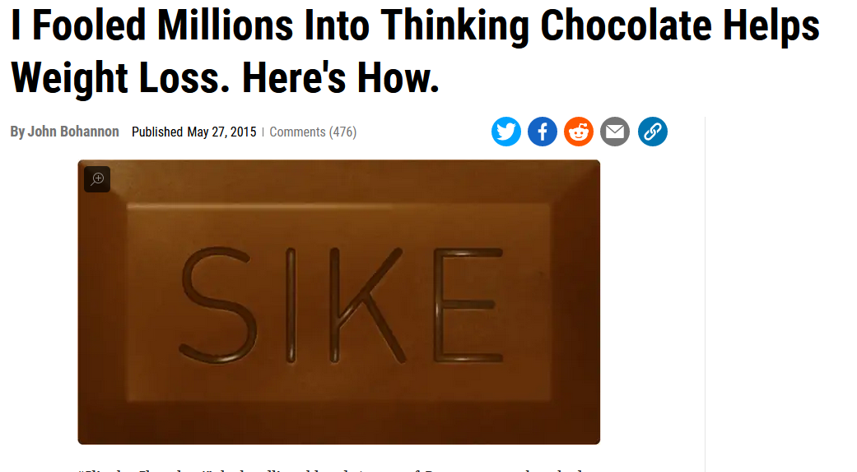
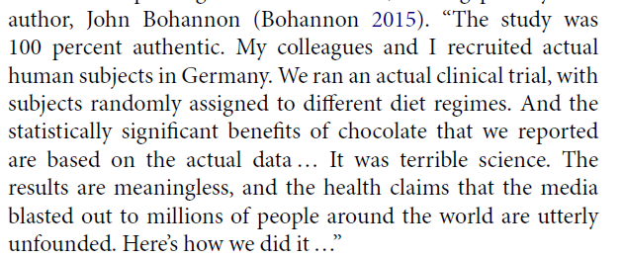

Slide 15


Two warm up exercises

Slide 16
A screening programme
bmj00615-0025.pdf
There is a proposal to offer a prostate cancer screening programme to men aged 50-64 years in your health economy, where such screening is not currently available.
There are doubts about the effectiveness of such a screening programme.
We will give you four statements derived from four different randomised controlled trials published in medical journals.
Assume that the costs of each programme are similar.
The results from each trial were deemed to be statistically and clinically significant.
During a seven year follow up:
  Programme A reduced the rate of deaths from prostate cancer by 34%
  Programme B produced an absolute reduction in deaths from prostate cancer of 0.06%
  Programme C increased the rate of patients surviving prostate cancer from 99.82% to 99.88%
  Programme D meant that 1592 people needed to be screened to prevent one death from prostate cancer.

Slide 17
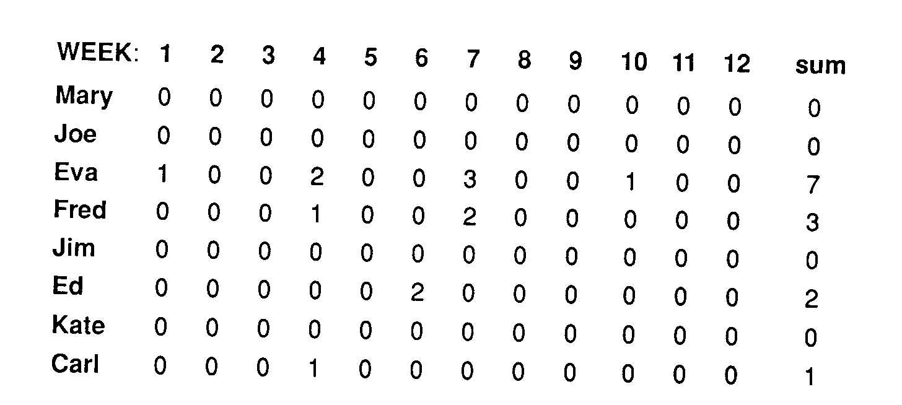
Identical task, identical conditions, serious error
What would a typical manager/supervisor do?
Source: Myron Tribus, BDA World Series 2, 1993

Slide 19
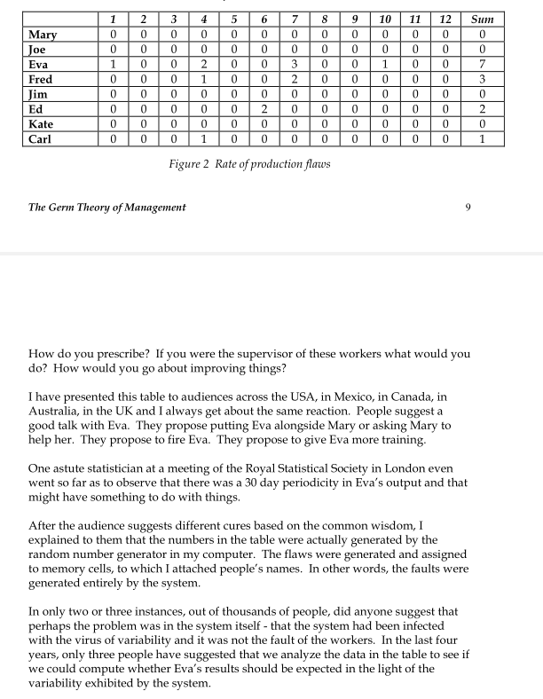

Myron Tribus (reference British Deming Association Booklet)

Slide 20
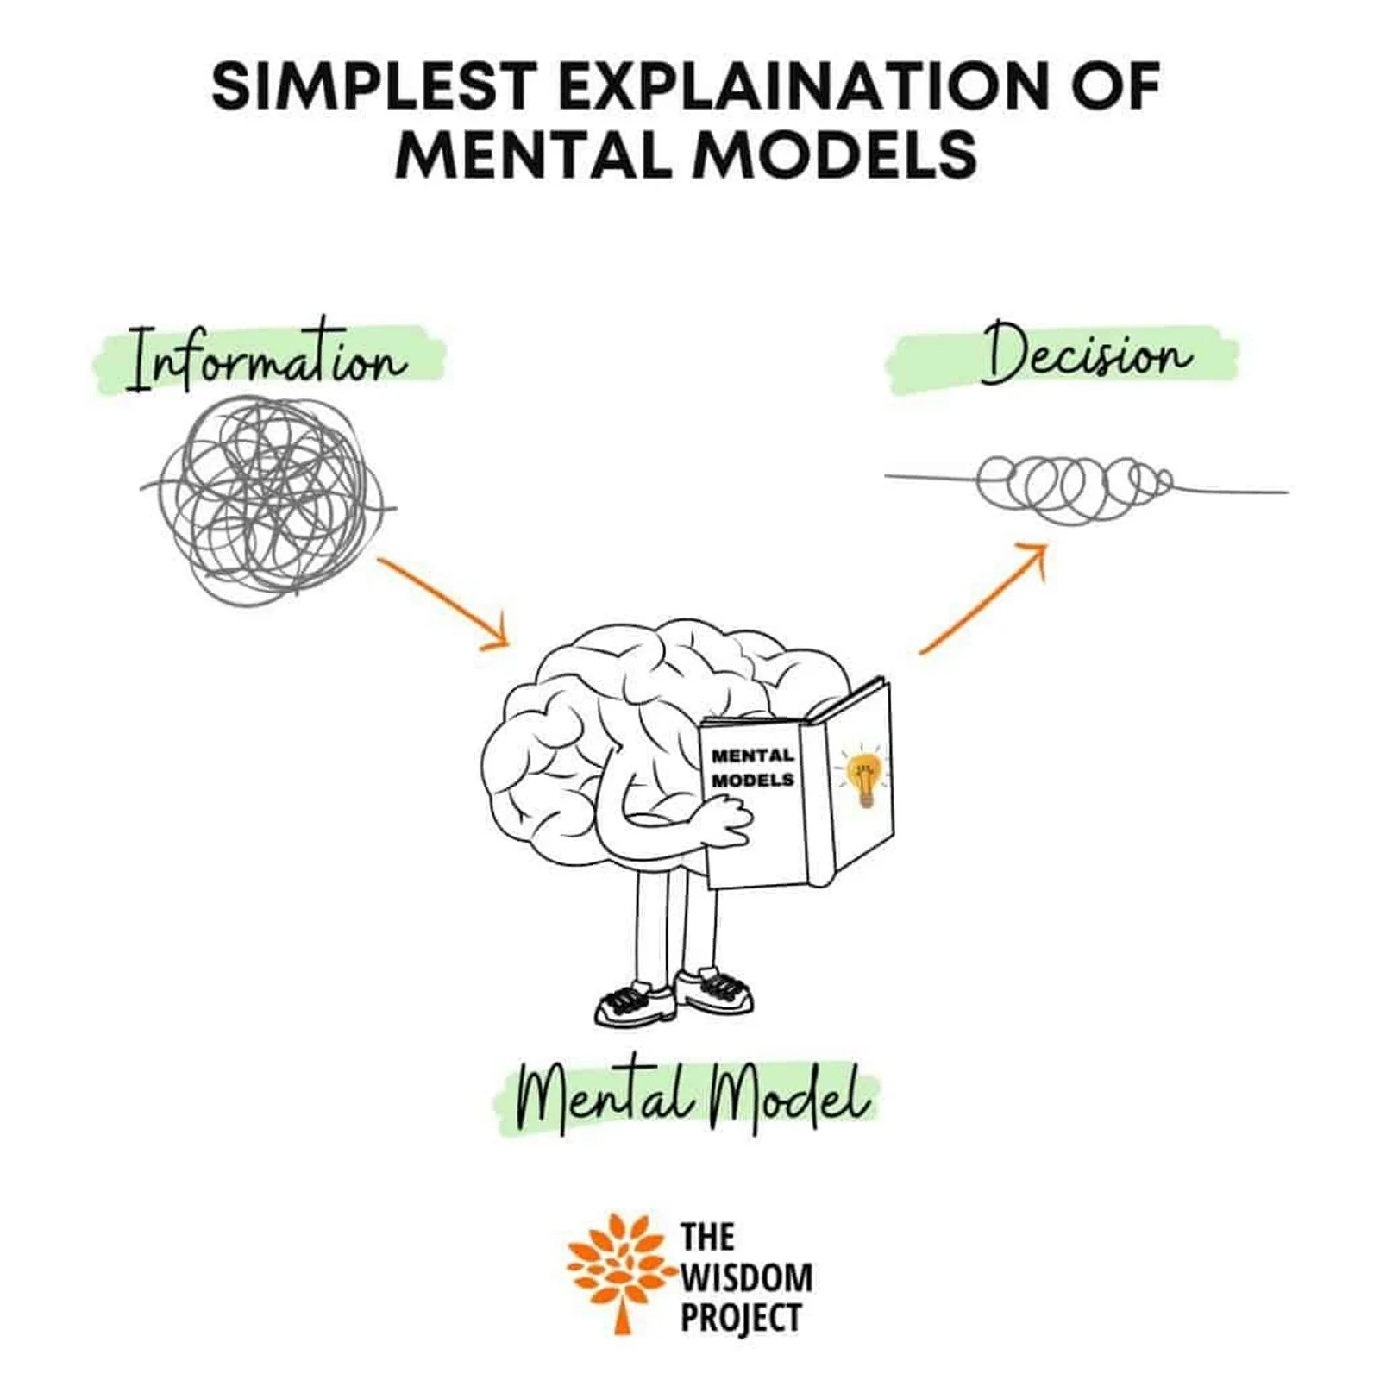
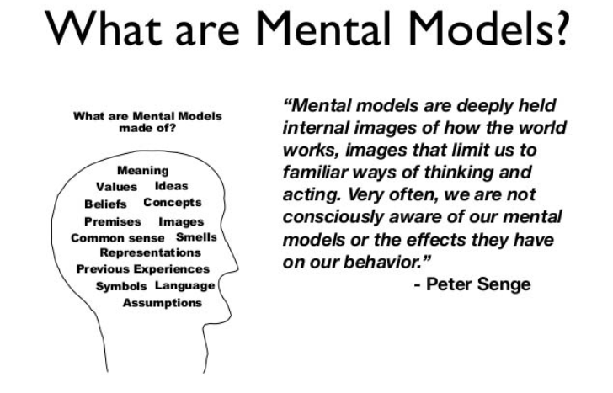

Slide 21
Some of our mental models are wrong – fallacious
“It Ain’t What You Don’t Know That Gets You Into Trouble. It’s What You Know for Sure That Just Ain’t So”
Mark Twain
“When your views on the world and your intellect are being challenged and you begin to feel uncomfortable because of a contradiction you've detected that is threatening your current model of the world...pay attention. You are about to learn something.”
William H. Drury, Jr. (1921-1992);
Professor, Author

Slide 22


Chanticleer’s Rooster
“He crowed every morning, putting forth all his energy, and flapped his wings. The sun came up. The connection was clear: his crowing caused the sun to come up. There was no question about his importance. There was a snag. He forgot one morning to crow. The sun came up anyhow.”
Chanticleer is the cock in Reynard the Fox from
Jean del la Fontaine’s Fables Choises Misses en Vers 1668

Slide 23
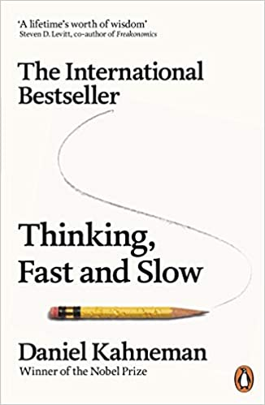



S1
S2
Notes:
Krockow, E. M. (2018, September 27). How Many Decisions Do We Make Each Day? Psychology Today. https://www.psychologytoday.com/ca/blog/stretching-theory/201809/how-many-decisions-do-we-make-each-day
Humans are thought to make around 35,000 choices per day, which makes it impossible for us to have the time, resources, or brain capacity to have all the information necessary to make a perfectly rational decision.¹³

Slide 24



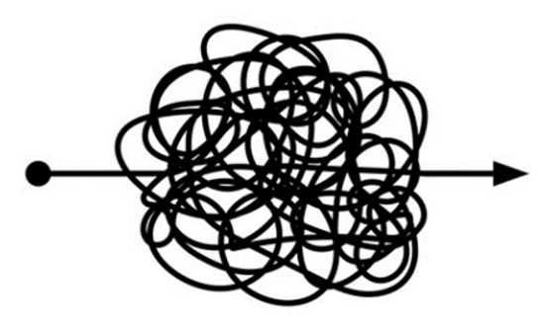
Decision making is challenging

Slide 25
So what does high-quality decision-making look like?

Slide 26

Notes:
And we need some common frame of reference to being clarity

Slide 27
Notes:
https://www.google.com/url?sa=i&url=https%3A%2F%2Ftheconversation.com%2Fcurious-kids-how-do-glasses-help-you-see-84363&psig=AOvVaw3V9VjtjX6uS5l6_zCDfCJC&ust=1627485126601000&source=images&cd=vfe&ved=0CAgQjRxqFwoTCOj2kt7Eg_ICFQAAAAAdAAAAABAG

Slide 28
The Six Dimensions of the Decision Quality Chain
Appropriate Frame
Appropriate Frame – are we addressing the right problem?...
Creative Alternatives - do we have a good set of alternatives?...
Clear Values & Trade-offs- does our decision fit our values and objectives?...
Relevant & Reliable information – do we have the necessary data & evidence?...
Sound analysis and reasoning – is our analysis logical and reasonable?...
Commitment to Action – are we ready to successfully implement this decision?...
Commitment To Action
Creative Alternatives
Decision Quality
(Chain)
Sound Analysis & Reasoning
Clear Values & Trade-offs
Relevant & Reliable information

Slide 29
Appropriate Frame
Commitment To Action
Creative Alternatives
Decision Quality
(Chain)
Sound Analysis & Reasoning
Clear Values & Trade-offs
Relevant & Reliable information

Slide 30
Our theory

Slide 31
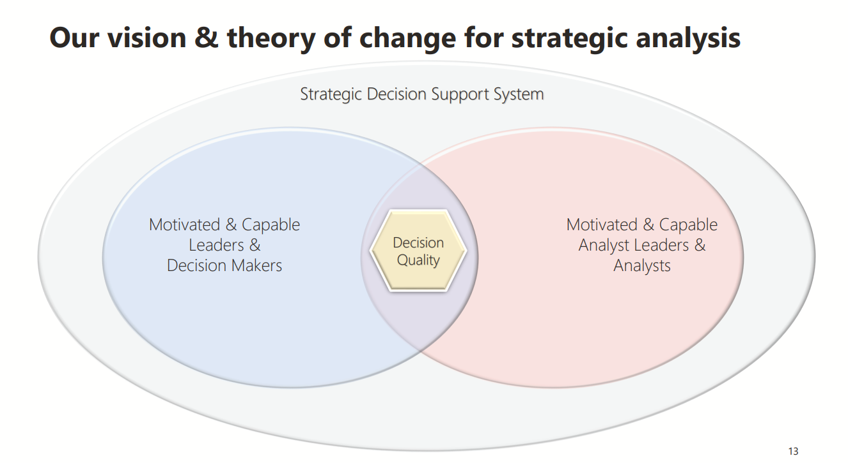

Slide 32
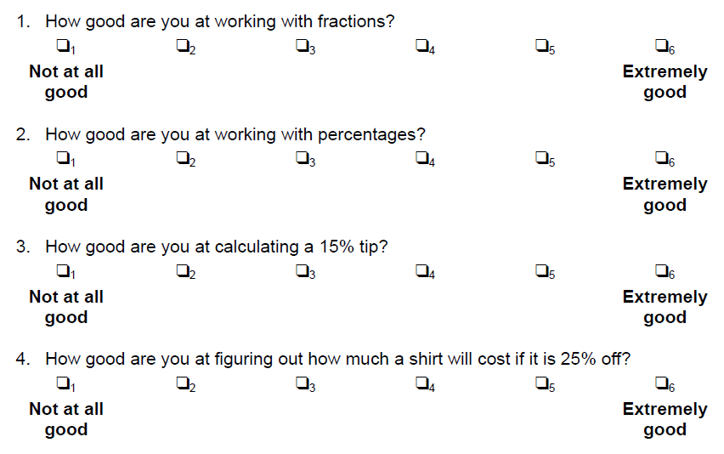
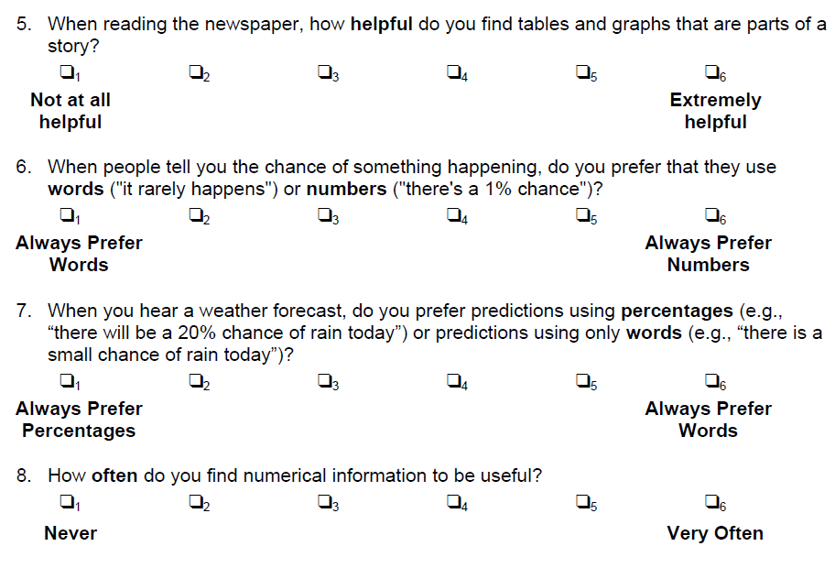

Subjective Numeracy Scale
32
Notes:
https://forms.office.com/Pages/DesignPageV2.aspx?origin=NeoPortalPage&subpage=design&id=zwd49LyvhEGleYZ4vqMBmnVTOg8_WDJNoXqfU-Y55zNUMTZSN0JEQjRCV1I2RVdTTzhGVklTN0ROUS4u

Slide 33
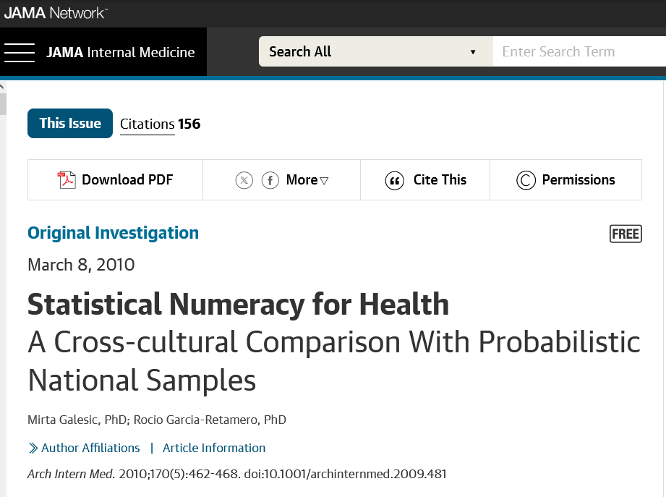
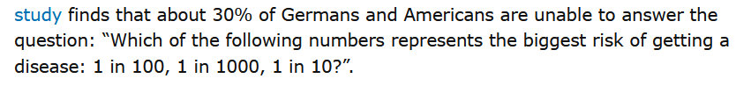
33

Slide 34
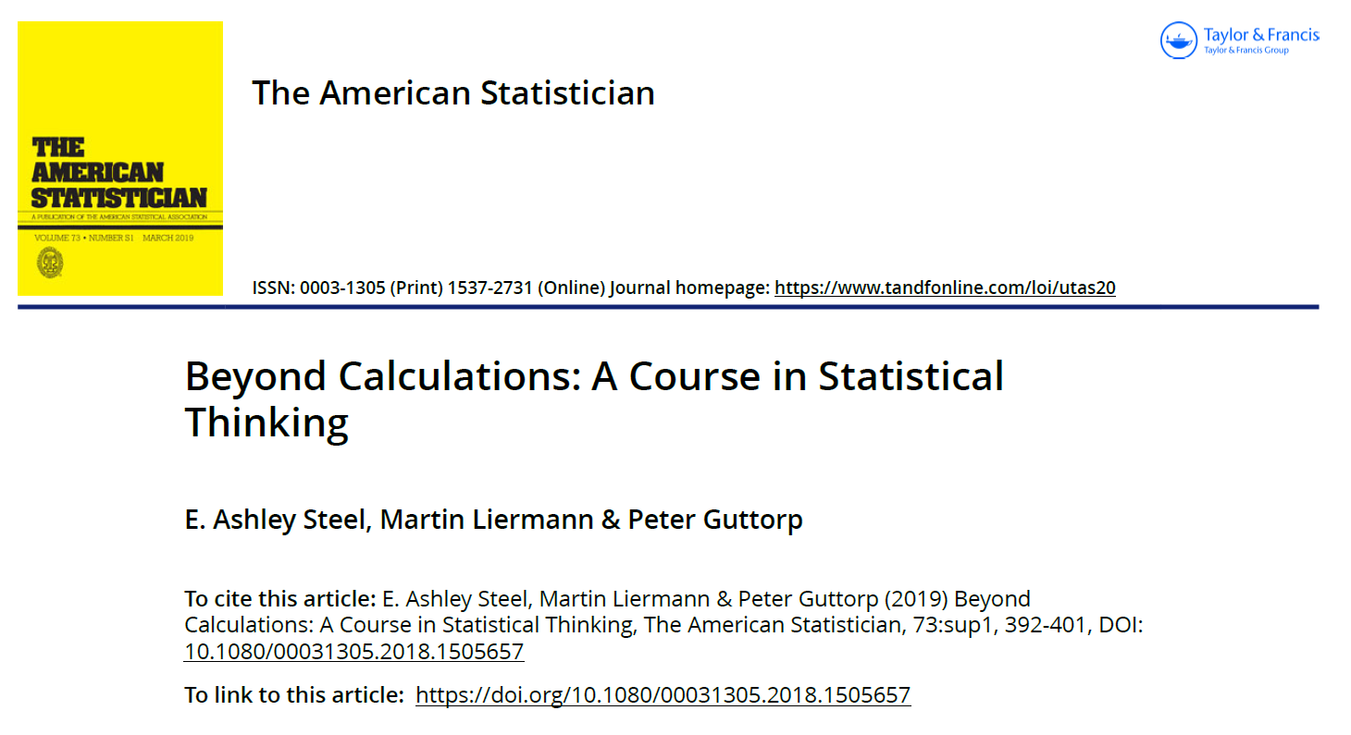
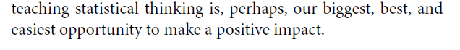

Slide 35
Decision Making
Variation & Uncertainty
Conceptual Insights

Slide 36
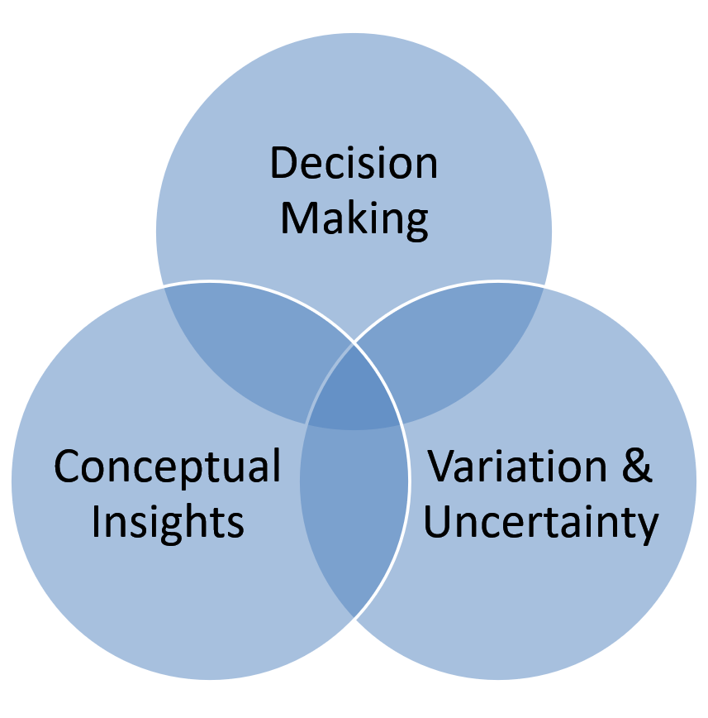


Slide 37
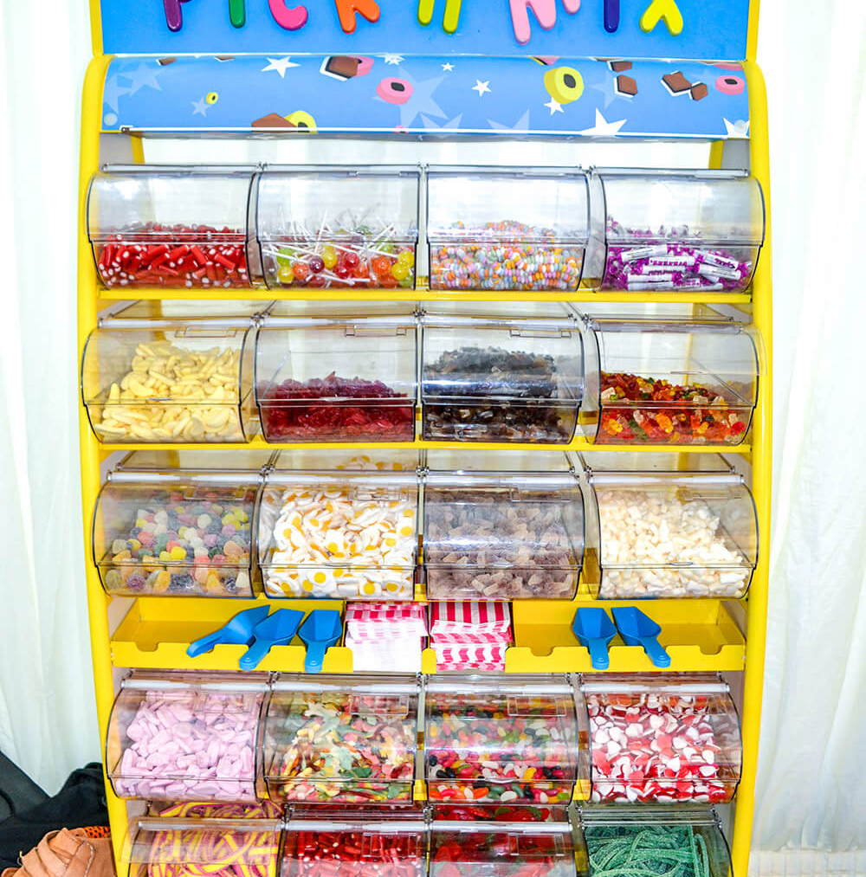

Slide 38
Understanding variation
(~25 mins)
Red bead experiment
(~30 mins)
Regression to the mean
(~10 mins)
Size matters: Little vs Large
(~10 mins)
P-values & CI
(~15 mins)
Insights from Systems thinking
(~10 mins)
Share Nicely
(~10 mins)
True Values &
One version of the truth
(~5 mins)
Waiting Lists
(~10 mins)
The language of uncertainty
(~10 mins)
Forecasting uncertainty
(~15 mins)
Handling uncertainty
(~30 mins)
Risk Communication
(~5 mins)
Every plan is a theory
(~10 mins)
Emergency theatre
(~5 mins)
Risk prediction
(~10 mins)
Hospital mortality statistics
(~15 mins)
Notes:
https://exchange.iseesystems.com/public/dmck/capa-ready-reckoner/index.html – tornado plot play model

Slide 39

















Understanding variation
(25 mins)
Red bead experiment
(30 mins)
Regression to the mean
(10 mins)
Size matters: Little vs large
(10 mins)
Misunderstanding
Variation
Insights from Systems Thinking
(10 mins)
Share Nicely
(10 mins)
One version of the truth
(5 mins)
Waiting lists
(10 mins)
Misunderstanding
Systems
The language of uncertainty
(10 mins)
Forecasting uncertainty
(15 mins)
Handling uncertainty
(30 mins)
Risk communication
(5 mins)
P values
(15 mins)
Uncertainty
Every plan is a theory
(10 mins)
Emergency theatre
(5 mins)
Risk prediction
(10 mins)
Hospital mortality statistics
(51 mins)
Incorrect
Mental Models

Slide 40
Share your insights…
Any key insights...
So what…
(any scope for application)
One wish…

Slide 41
The most precious gift you can give someone is the gift of your time and attention
Nicholas Gumbel

Slide 42
Tips for change
COM-B
Leaders play a critical role in facilitating both organizational change and behavior change by communicating a compelling vision, providing support and resources, modeling desired behaviors, and empowering employees to adapt and innovate.
Personal
  Build habits
  Seek social support
  Monitor progress
Organisational
  Lead by example
  Compelling vision
  Playgrounds
  Training and support
  Anticipate resistance
  Monitor and adapt
  Celebrate progress

Slide 43
Understanding variation
(~25 mins)
Red bead experiment
(~30 mins)
Regression to the mean
(~10 mins)
Size matters: Little vs Large
(~10 mins)
True Values
One version of the truth
(~5 mins)
The language of uncertainty
(~10 mins)
Forecasting uncertainty
(~15 mins)
Handling uncertainty
(~30 mins)
Risk Communication
(~5 mins)
P-values & CI
(~15 mins)
Every plan is a theory
(~10 mins)
Emergency theatre
(~5 mins)
Risk prediction
(~10 mins)
Hospital mortality statistics
(~15 mins)
Insights from Systems thinking
(~10 mins)
Share Nicely
(~10 mins)
Waiting Lists
(~10 mins)
Notes:
https://exchange.iseesystems.com/public/dmck/capa-ready-reckoner/index.html – tornado plot play model

Slide 44
Analytical projects typology
Problem structuring
Data management
Descriptive analytics
Explicative analytics
Predictive analytics
Prescriptive analytics
Evaluative analytics
Communicating results
Enhancing decision quality

Slide 45
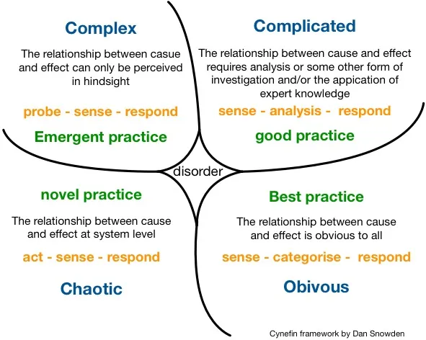

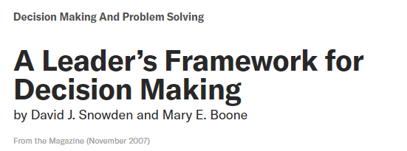

Slide 46
Problem Structuring -
deriving a problem definition and analytical plan from a presenting management, clinical or operational context.
Data Management -
information governance, data ethics, data processing, wrangling, and linkage
Descriptive Analytics-
What is the world like now and in the past? Using multiple data sources to provide a coherent overview of activity, resource use, performance, quality, efficiency, experience and outcomes.
Commonly used methods: Summary statistics, data visualisation, geospatial mapping, metric development and derivation, prevalence studies, experience surveys.
Explicative Analytics -
Why is the world the way it is? Exploring and explaining observed patterns of activity, performance and outcomes and the variation in these between groups and over time.
Commonly used methods: Explanatory regression modelling, inferential statistics and hypothesis testing, data-mining, observational (risk) studies, choice experiments.
Predictive Analytics -
What might the future hold for patients, services and populations? Estimating how activity levels, performance and outcomes change in the future under different assumptions and scenarios.
Commonly used methods: Time series forecasting, risk prediction, machine learning, scenario planning, simulation, ex-ante modelling, epidemiological and demand modelling.
Prescriptive Analytics -
What should we do? Providing specific advice for decision makers in order to make best use of available resources to maximise health outcomes
Commonly used methods: Opportunity assessments, options appraisals, resource allocation, resource planning, scheduling, optimisation, statistical process control, decision aids and decision analysis.
Evaluative Analytics -
Did it make a difference and was it worth it? Estimating the impact and costs of changes that are or have been made to the health system to inform decisions about implementation and whether to continue / roll-out.
Commonly used methods: Causal inference, logic modelling, experimental and quasi-experimental studies, directed acyclic graphs, contribution, mediation and moderation analysis, cost effectiveness, cost benefit and return on investment analysis.
Communicating results -
constructing narratives, report writing, data visualisation, verbal presentation, conveying risk and uncertainty, describing concepts and methods to non-technical audiences.
Enhancing decision quality -
supporting decision makers and the decision-making process with problem formulation, relevant & reliable data, evidence and analyses to evaluate alternatives, sound & insightful reasoning and effective communication

Slide 47
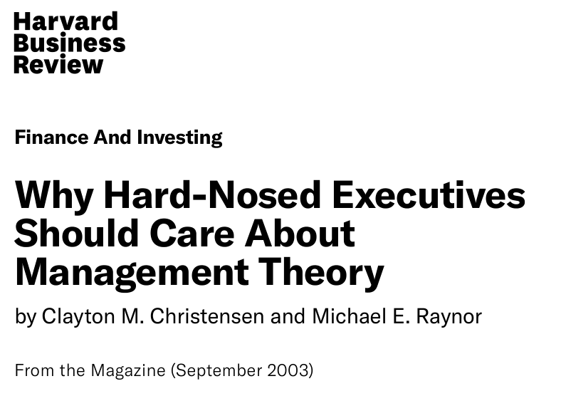
“…..most managers don’t realize that they are voracious users of theory.”

Slide 48
Practice changes but principles persist

